Slide 1

How does on-pitch performance impact commercial success in the English Premier League (EPL)?
By Uyi Erhabor
June 2025

Slide 2
Introduction
Presentation structure:
Methodology
Executive summary of findings
Explanation of findings
Strategic recommendations
Case study 1
Case study 2
Important considerations
Q&A

Slide 3
Methodology
Data sources:
On-pitch performance data (points totals, league position): FBref
Off-pitch performance data (revenue): Deloitte Money League, Companies House
Data Preparation:
Filtered Deloitte Money League data for EPL teams' revenue data
Collected revenue data for EPL teams not in Deloitte Money League from Companies House
Filtered FBref EPL standings data for team, points totals and league position data
Standardised team names across the on-pitch and off-pitch datasets
Combined the on-pitch and off-pitch datasets for the 2019/20 to 2023/24 seasons
Analysis:
Correlation analysis (identifying relationships)
Regression analysis (quantifying the impact of on-pitch performance on commercial success)

Slide 4
Executive Summary
A strong positive relationship exists between points totals and revenue
A strong negative relationship exists between league position and revenue
On-pitch performance has positive and negative quantifiable impacts on commercial success
In a worst-case scenario there is commercial success that can be achieved in the Premier League
Points totals and league position are significant on-pitch performance factors that drive commercial success

Slide 5
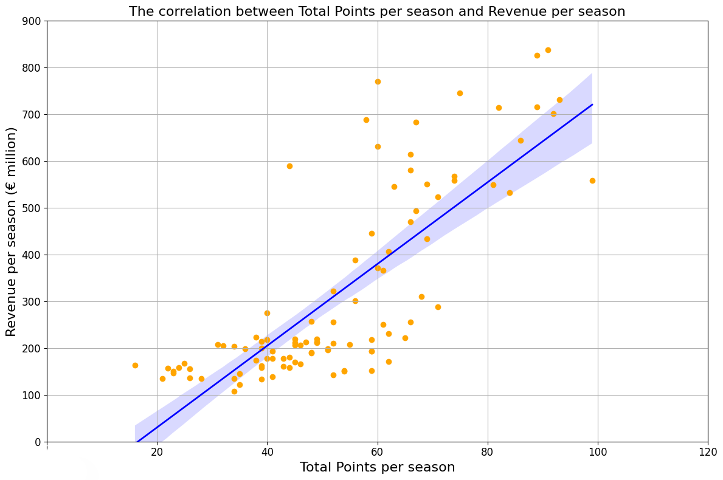
Strong positive relationship between points totals and revenue
Correlation coefficient of 0.79

Slide 6
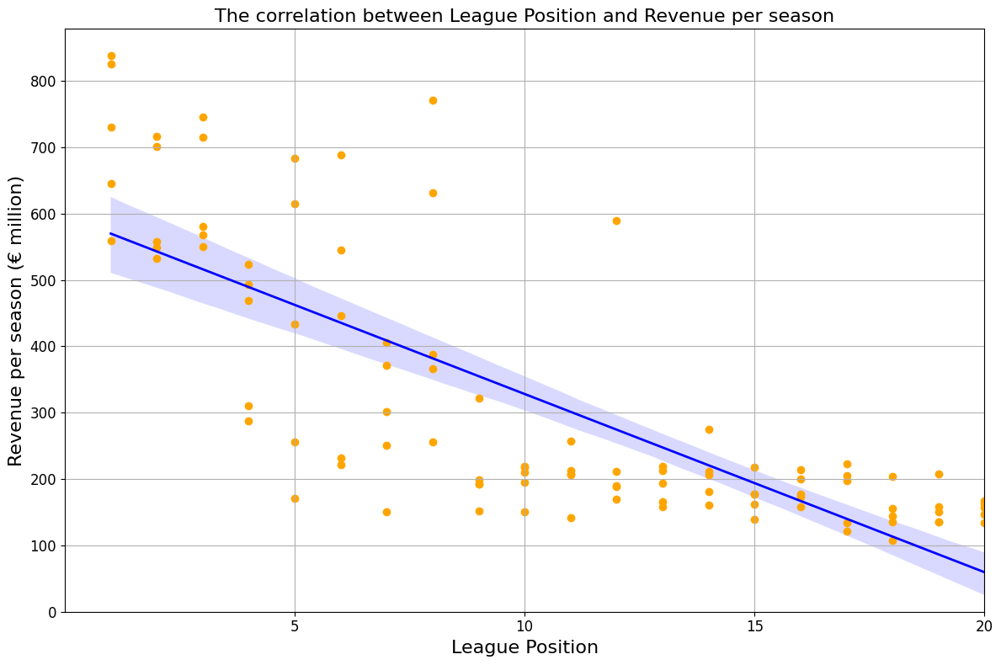
Strong negative relationship between league position and revenue
Correlation coefficient of -0.77

Slide 7
How much can an additional point contribute to revenue?
Estimated revenue impact of an additional point over the 5-season period
+2.54%

Slide 8
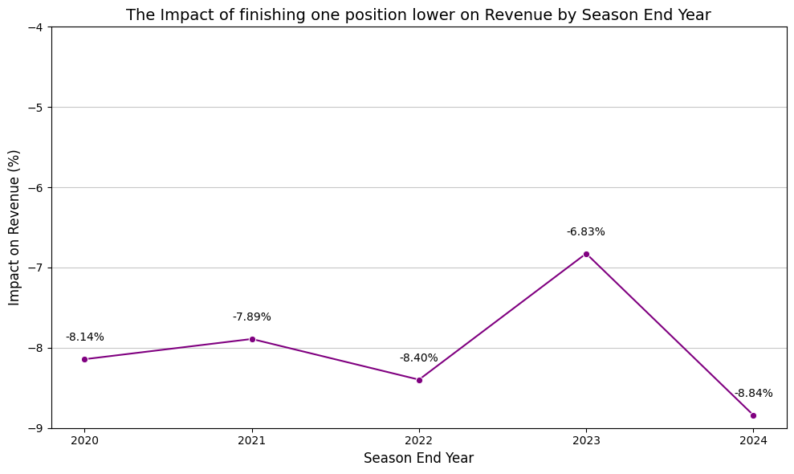
How does a lower league position impact revenue?
Estimated impact of finishing one position lower of -8.02% over the 5-season period

Slide 9
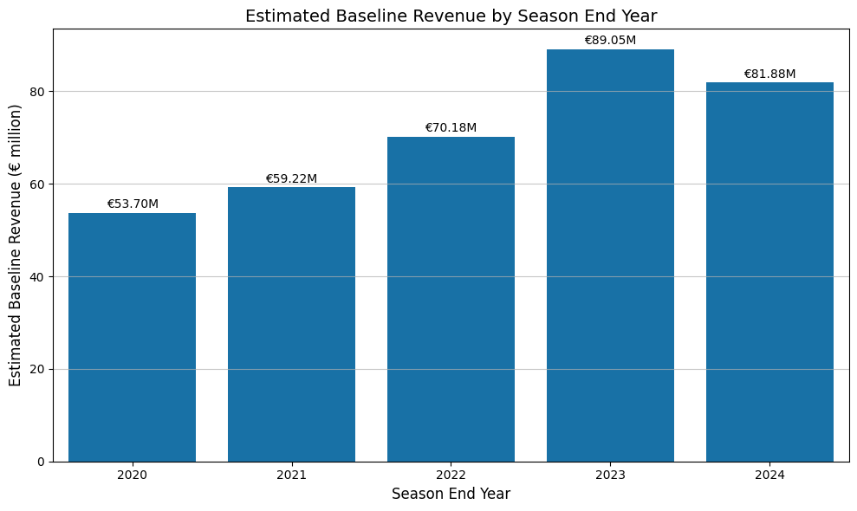
Commercial success can be achieved in a worst-case scenario
Baseline revenue: revenue earned in a 0 point/minimum performance season
Estimated baseline revenue of € 69.70m on average across the 5-season period

Slide 10
The significance of points totals and league position in driving commercial success
R-squared: a measure of the importance of one variable in determining another
Points totals and league position have R-squared values of 70% in terms of their ability to predict revenue

Slide 11
Strategic recommendations
Invest in squad development to maximise on-pitch performance and commercial success as an additional point is estimated to increase revenue by 2.54%
Utilise estimated baseline revenue (€69.70m) in setting minimum expectations of commercial success in the EPL

Slide 12
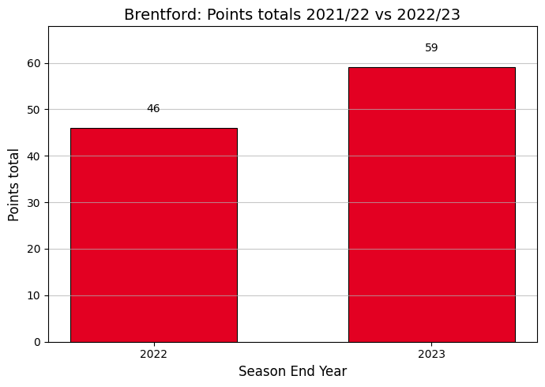
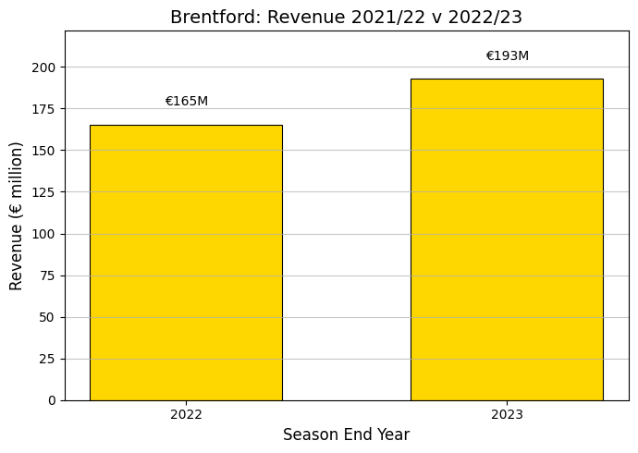
Case study: Brentford
League position 2021/22: 13th
League position 2022/23: 9th

Slide 13
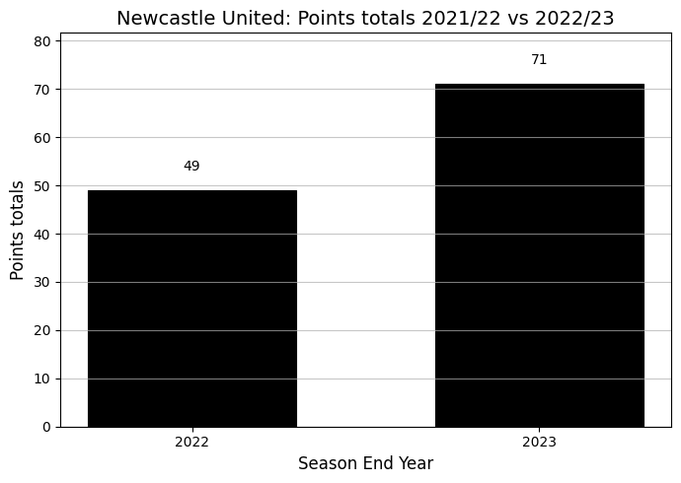
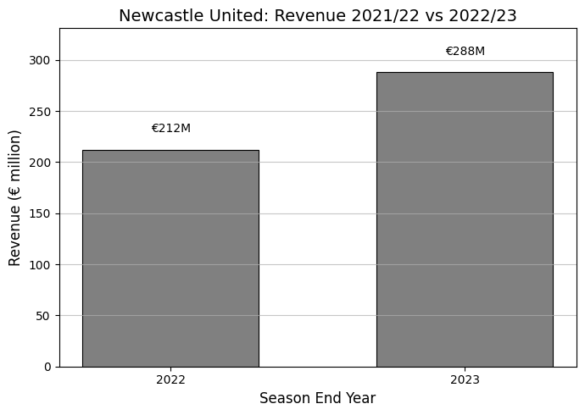
Case study: Newcastle United
League position 2021/22: 11th
League position 2022/23: 4th

Slide 14
Important considerations
Analysis of a larger dataset e.g. 10 seasons may reveal different estimates
There are other factors other than league position and points totals that influence commercial success

Slide 15


